Slide 1

TDSnaps at Oaklands
Jim Marshall Assistant Head KS2

Slide 2
Intent
Our Vision: To provide exceptional learning experiences, where staff empower students and their families to be thriving members of their communities
Majority of our students have poor verbalisation skills and ned to use symbols to communicate. This difficulty in communication leads to a struggle in regulating their emotions and impacts on their independence.
Worked with SALT to identify TDSnap (AAC Software)
Trailed AAC devices for students to use
Embed the practice across the school, to raise attainment for all

Slide 3
Implementation
SALT delivered training to staff to use TDSnap in the classroom
Students baselines and identified for first trial
SALT delivered targeted training to the parents of trail students
Six students currently using devices

Slide 4
Next steps
TDSnap training for all staff to use via the classroom Interactive Whiteboard
Parent workshops to upskill parents using TDSnap
iPads available for students to trail their suitability to the software

Slide 5
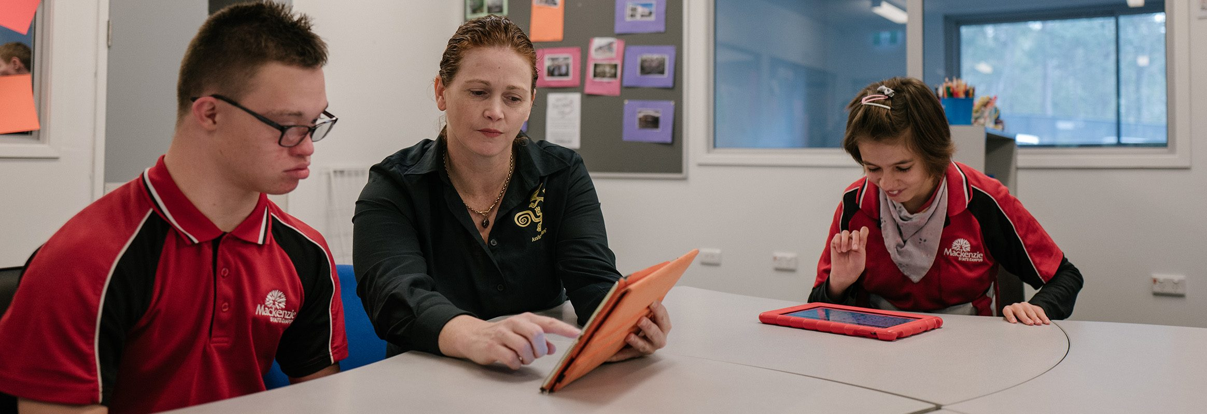
AAC Inset
Augmentative and Alternative Communication (AAC)
January 2025

Slide 6
The ultimate goal for AAC
Expressing exactly what you want to say (your thoughts exactly) to communication partner WHEN you want to using YOUR preferred communication method and others VALUING that message.

Slide 7
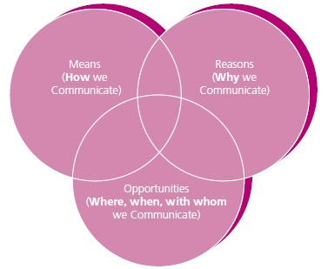
Means, Reasons, Opportunities
Communication
Money, 2002
Notes:
We will look at
Means: How is the student communicating
Reasons: wants/needs, to request, give information, protest, discuss feelings, make choices
Opportunities: Time, place, conversation partner, shared language, shared communication, shared interests, friends, family, teachers
Functional communication requires equal interaction between means, reasons and opportunities
Without the means of communication you cannot express yourself
Without reasons for communication there is no point in communicating
Without opportunities there cannot be any communication

Slide 8
How best to model for AAC support
Point to key words as you say them – you don’t have to model complete sentences all the time
Don’t ask the child to imitate you all the time
Teach and model, don’t test
Respect all ways of communicating and encourage the use of the device
Create opportunities for use
Repetition with variety
Pause and wait for response
Add words – extend words or phrases
Think about the skill you are trying to teach – what is the target?
Remember your prompt hierarchy
Include a variety of communication functions
Notes:
People who are developing language through AAC, like second language learners, do best when immersed in an environment where people are speaking AAC all day long
Recommended 20 opportunities per hour for continued language learning.

Slide 9
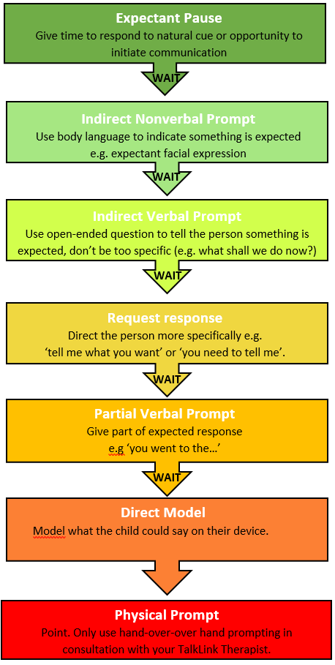

Prompt Hierarchy for AAC
Notes:
Physical prompt – We do not use this
Direct model
Partial verbal prompt
Request response
Indirect nonverbal prompt
Expectant pause

Slide 10
AAC Do’s and Don’ts
Do:
Use the AAC system yourself
Do aim high
Create opportunities (Special Times)
Allow exploration
Provide time
Ask open ended questions
Focus on key words when modelling
Respect multi-modal communication
Provide device at all times, all day, every day
Use well designed, research based vocab
Describe what you say using core words
Don’t:
Expect the user to communicate without you modelling how
Don’t do all the talking
Limit access to device
Only provide nouns
Don’t focus on adding lots of new vocabulary
Use the system to quiz or test
Reward communication with food
Require them to say it with their words if they can do it another way
Notes:
Aim high e.g. assume competence
Allow exploration, allow time to explore the device
What does the child want?
What do we want from AAC?
What is the practical solution to our current system?

