Slide 1
Communication and communication support
By Rachel siew, preti patel & Tammy creecy

Slide 2
Communication pyramid
Communication skills are vital for learning, play, friendships, and wellbeing. Children develop at different rates, but there are typical stages of communication development from birth to age 14+
The Communication pyramid shows those stages of communication development. The skills at the bottom should provide the foundation for the skills at the top of the pyramid. It’s important to get the foundation right before moving onto the other skills.

Slide 3
Activity
Split into groups
In groups discuss what order you feel the skills go (remembering bottom should provide the foundation!) Discuss the skills and reasons why you feels those skills should be placed there on the pyramid. (Have fun)

Slide 4
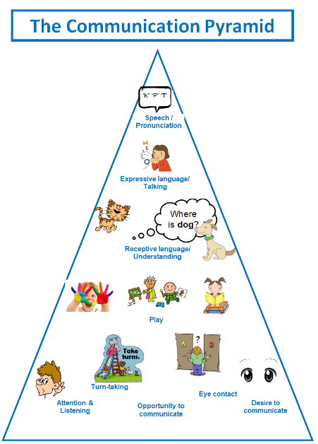
Attention & Listening
Attention and listening refers to the ability to notice, engage with, and respond to sounds and cues in their environment. It includes the ability to wait, look, and listen, and to attend to others when spoken to as well as attending to activities and tasks.
​
Play & Social Interaction
Play develops as children grow and learn, from early sensory exploration, through functional play such as stacking block, to pretend and imaginative play as they use what they learn and observe in life in their play. Social interaction builds on the early interaction skills established to develop relationships and friendships and begin to play and share with others.
​
Understanding
Understanding refers to a child's ability to understanding the spoken language used around them. It includes their ability to follow instructions, answer questions, and respond to prompts and cues.
​
Expressing
Expressive language refers the child's ability to communicate through 'formal' language, however this may include signing, symbols, objects (Augmentative and Alternative Communication) as well as spoken language. It refers to the ability to communicate functionally and join 'words' and ideas together.
​
Speech
When using verbal language, speech refers to the clarity of words and accuracy of sound productions. Children present with a range speech sound errors which typically resolve as they develop.
Notes:
Preti

Slide 5
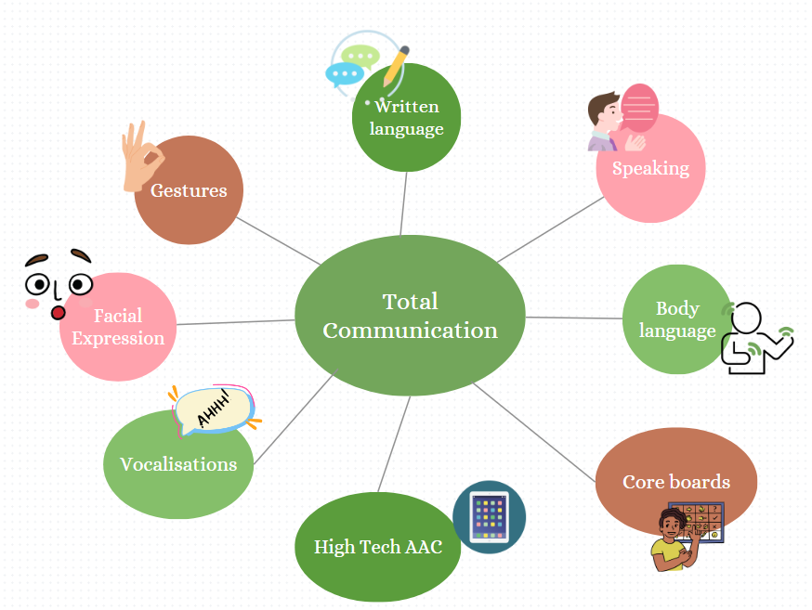
Total Communication Approach
Oakland School supports a total communication approach.
  This means we accept ALL types of communication and your children communicate through many methods.
  We allow your children to communicate in the most accessible way to them

Slide 6
Strategies to support communication at home

Slide 7

Silence is golden
‘8 Second rule’
Count to 8 seconds in your head, this allows your child to process information effectively
This means they are more likely to respond and communicate more effectively.
O.W.L
Observe
Wait
Listen
Create opportunities for the your child to respond by building pauses into familiar routines and highly motivating activities
For example, pause after blowing bubbles to see if they will reach for the item, look at you, or verbally request ‘more’

Slide 8

Repetition
Most your children with a speech and language difficulty need repetition to develop or even maintain a skill
Where possible, choose a small number of activities to repeat in various formats, rather than giving continually new experiences
This will give them the opportunity to build anticipation whilst consolidating learning

Slide 9

Model language
Avoid telling your child, 'say hi' or 'say I want more'
Verbally prompting your child to speak or use their AAC causes your child to be dependent on your verbal prompts and it also demotivates them from spontaneous communication
Communication is meaningful and fun
Comment on what your children are doing and model what they can say in situations
  When they are enjoying watching a music video, say 'This is nice!' Or 'We like it!'.

Slide 10
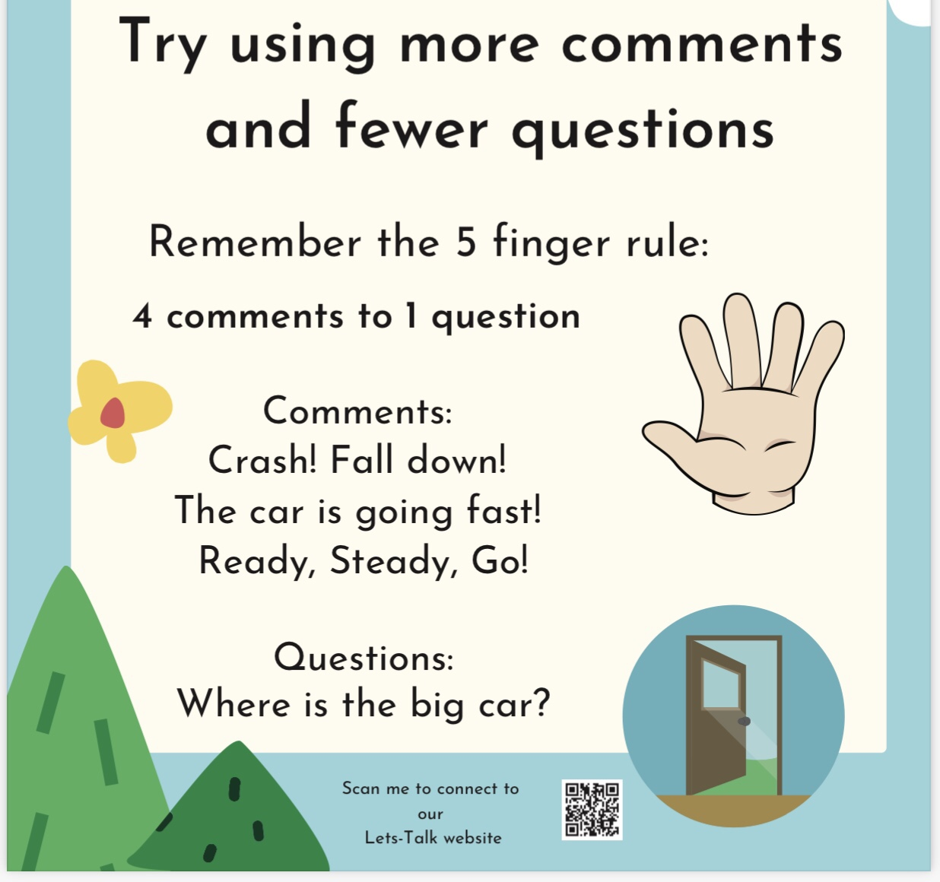

Slide 11
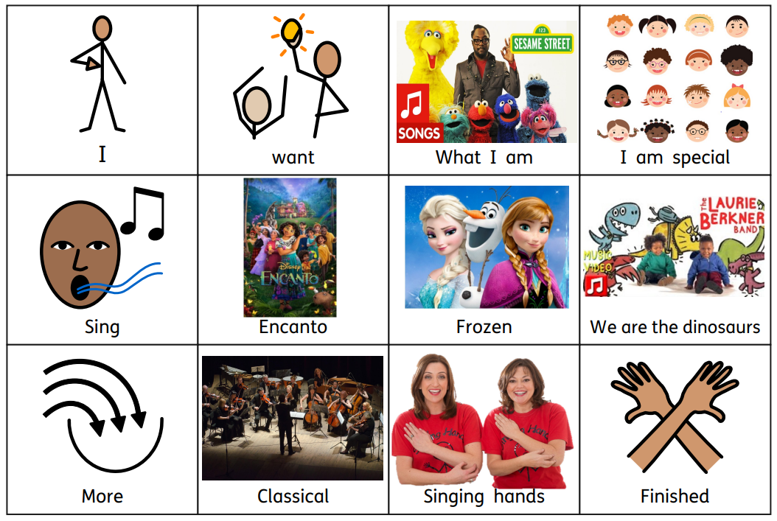
Communication boards

Slide 12
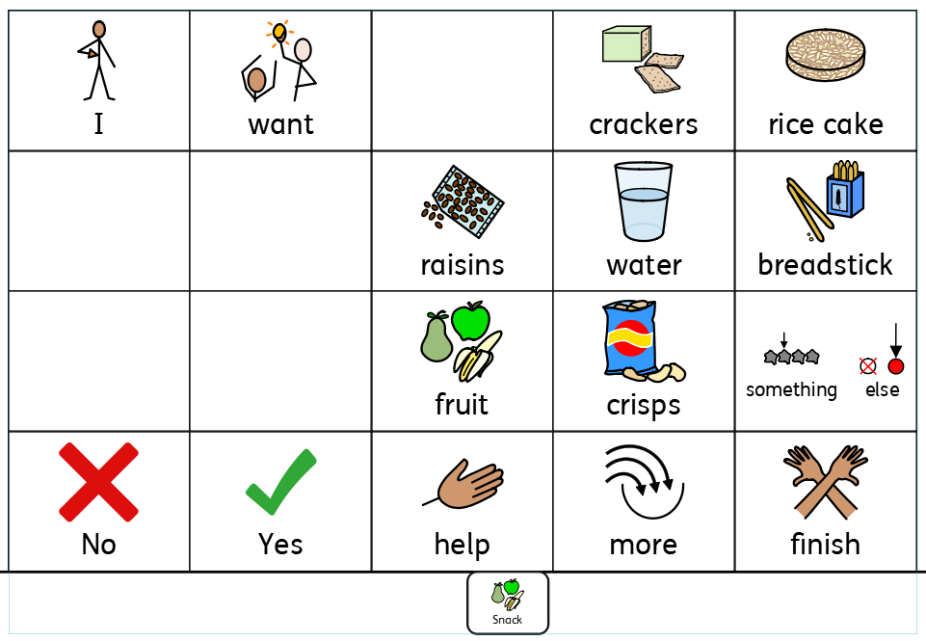

Slide 13
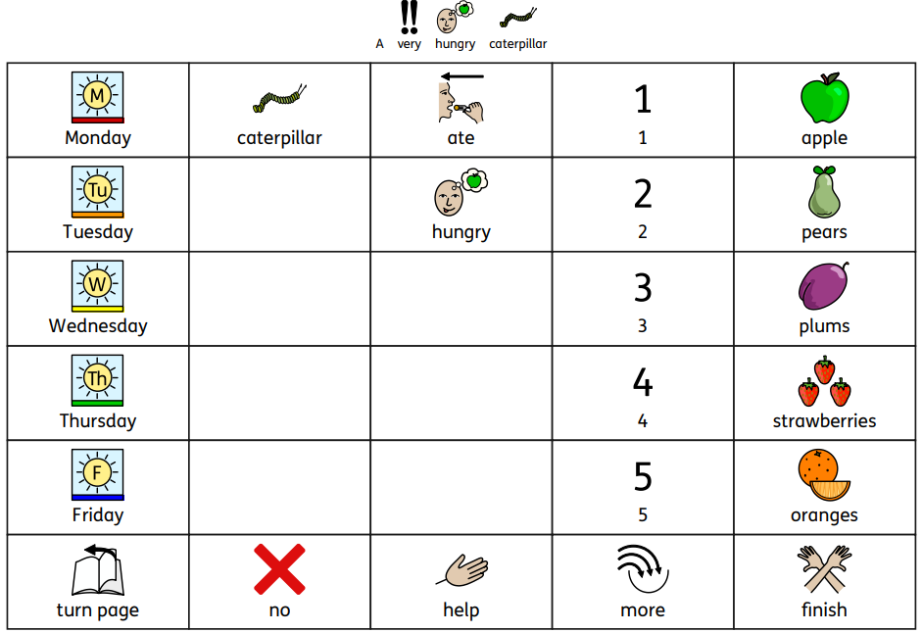

Slide 14
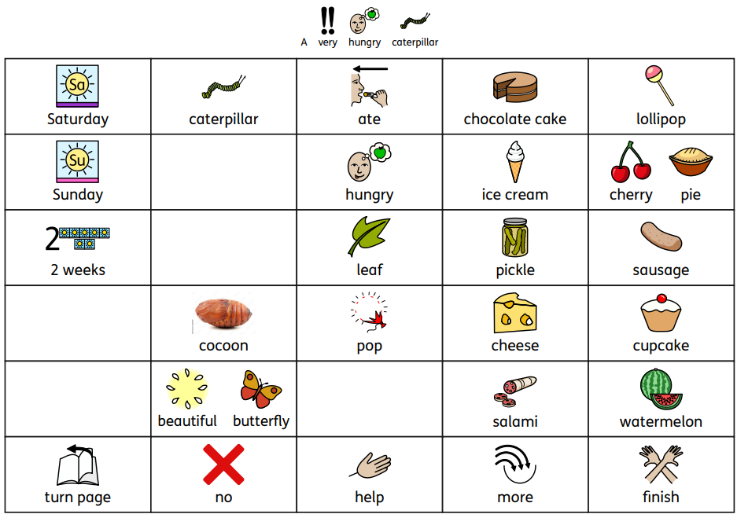

Slide 15

Makaton
We use ‘Makaton’ as our main method of signing across the whole school.
It is designed to support spoken language therefore signs are used as well as speech, in spoken word order.
It can be used as a visual cue or can support students to express themselves
Let's learn a few!

Slide 16
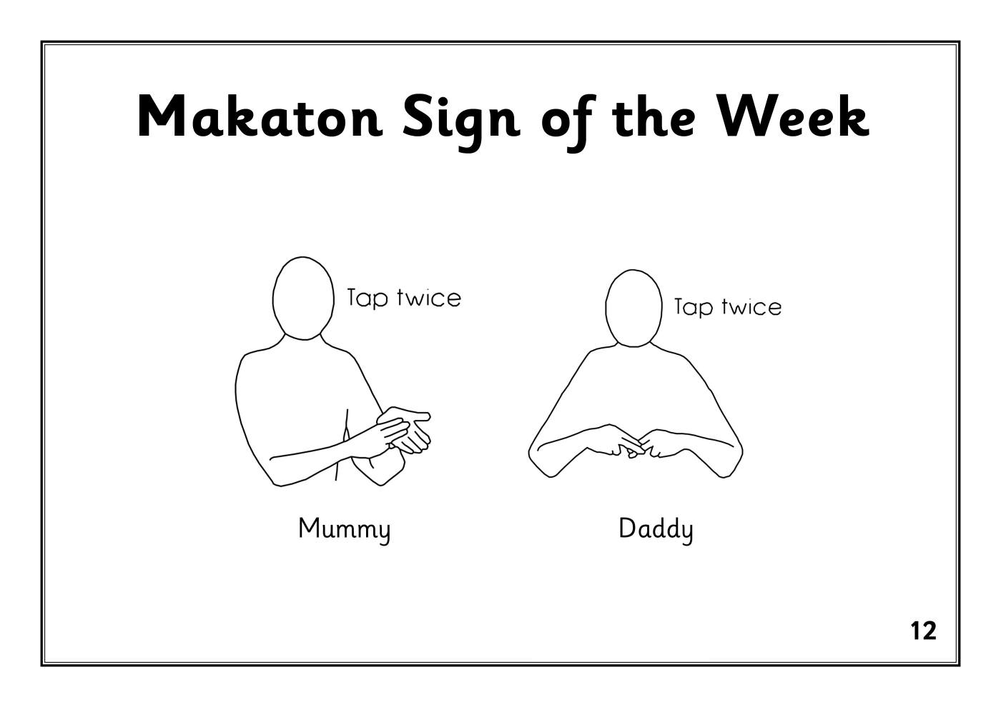
Mummy and Daddy

Slide 17
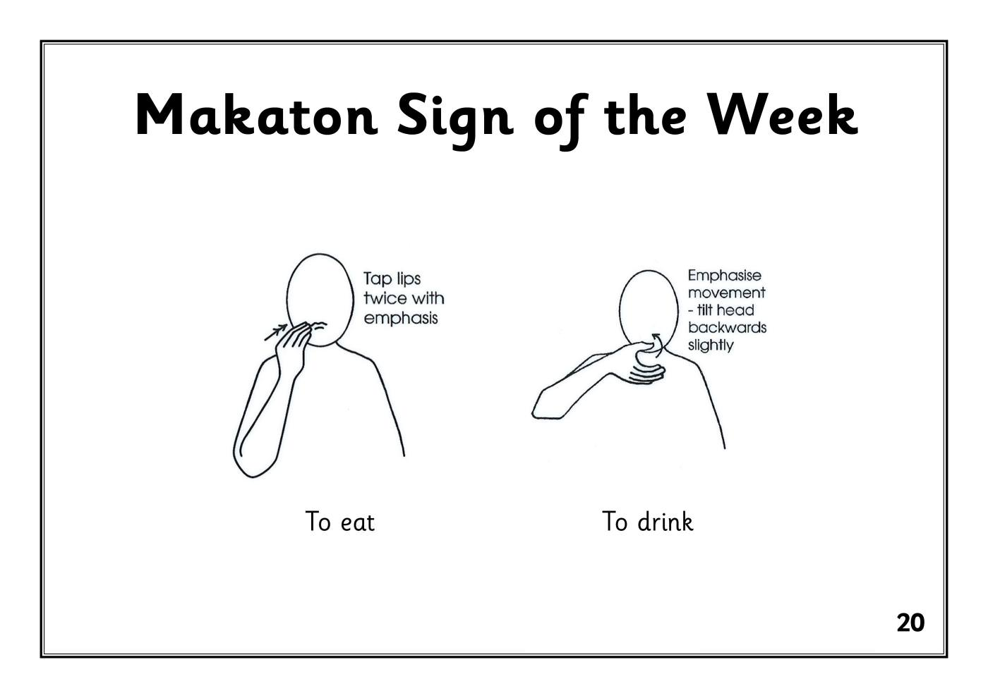
Eat and drink

Slide 18

Toilet

Slide 19


Slide 20

Coffee Break

Slide 21
Explore Communication Resources used in school
Colourful Semantics
  Colour coded visual support to teach grammar and sentence structure
Core boards
  Paper based AAC, used for students to express themselves and make choices
Games
  Develop turn taking skills, receptive language and vocabulary
Attention Autism
  Increase independent attention towards adult led activities
TD Snap
  Power based AAC, used for students to express themselves and make choice
Now and Next boards
  help manage expectations, support transitions, and encourage task completion

