Slide 1
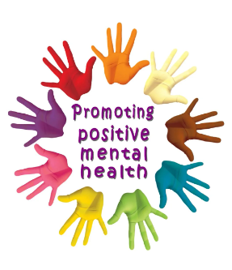

Supporting Pupil’s Mental health and Well-Being
Asimina Mourelatou

Slide 2
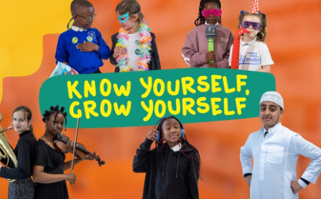

Children's Mental Health Week 2025
Children's Mental Health Week 2025 will take place from 3–0 February 2025.
This year's theme is ‘Know yourself, Grow yourself'.
‘’The theme for 2025 is focus is Know Yourself, Grow Yourself, with the aim to equip and empower children and young people across the UK to embrace self-awareness and explore what it means to them. We want children and young people to discover how getting to know who they are can help them build resilience, grow and develop (https://www.childrensmentalhealthweek.org.uk/ )’’.

Slide 3
Aims of the CPD
To share how we can support mental health and well-being in our pupils and how this links with PSHE/RSE - PSED and Development Matters
To highlight how building secure, trusted, relationships can help develop resilience and well-being in young people

Slide 4
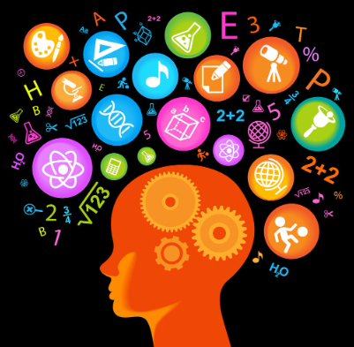
What is Mental health? Well-Being?
Ideas, words, phrases?

Slide 5
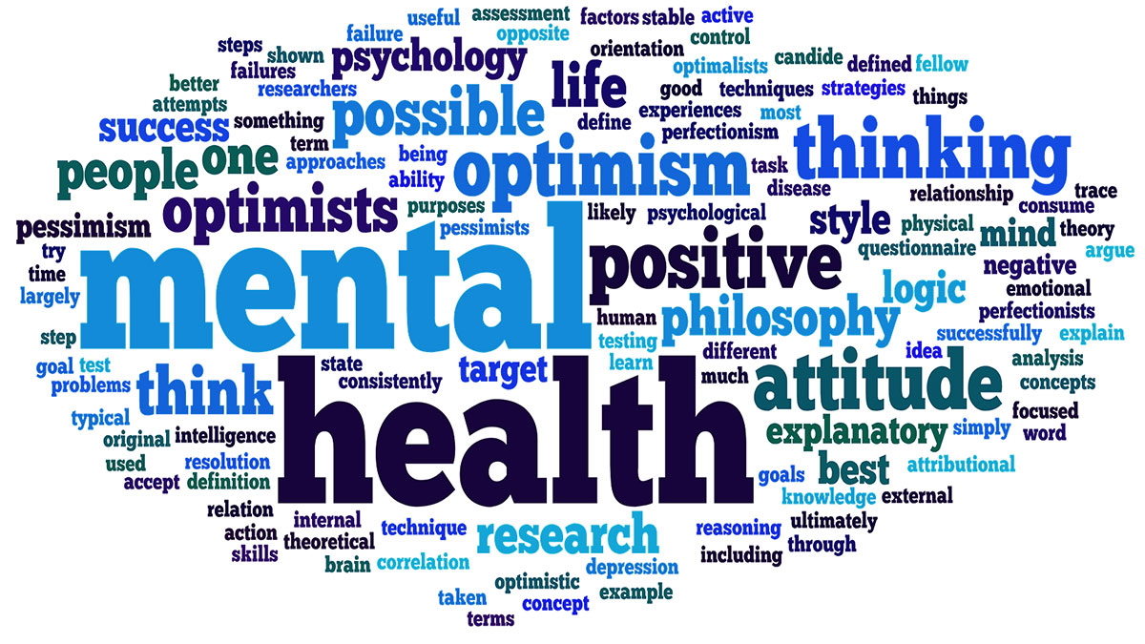
‘a state of well-being in which every individual recognizes their own potential’
‘coping with the normal stresses of life’
‘working productively and fruitfully’
making a contribution to our communities….’
(WHO 2014)
‘dealing flexibly with to ups and downs’
‘it ebbs and flows, functioning well and not so well’
(Place2Be)
‘like physical health, it’s not static’
‘about ordinary living –about physical and emotional well-being’

Slide 6
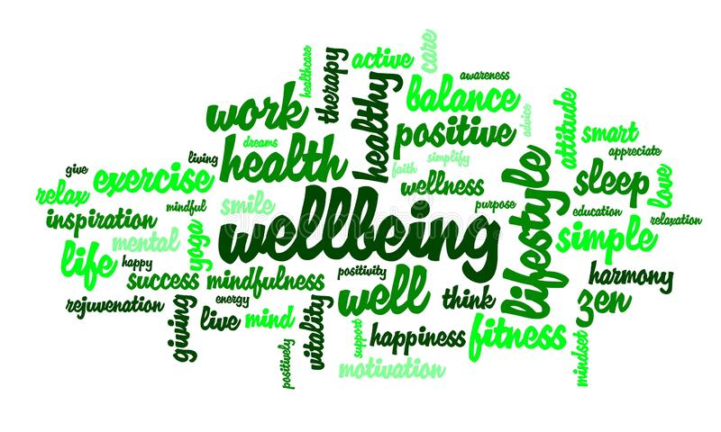
‘feeling good and functioning well’
‘feelings of happiness, contentment, enjoyment, curiosity’
‘experiencing positive relationships, secure attachments’
WELL-BEING
‘equally important is our functioning in the world’.
‘a positive experience of life’
‘having some control over one’s life’

Slide 7
Why children’s mental health is important?
Good mental health is key to the healthy development and wellbeing of every child.
Mental health has a complex interactive relationship with children's physical health and their ability to succeed in school, at work, and in society.
Good mental health helps children develop socially, emotionally, mentally and physically.

Slide 8
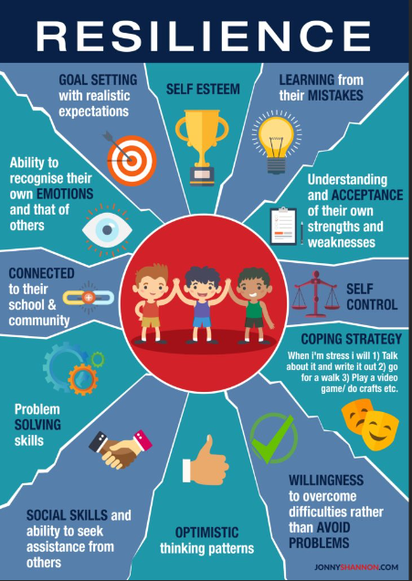
How do we support children’s mental health?

Slide 9
How do we build resilience?
Co-regulation
(be dependent on another)
Positive relationships
Positive relationships have direct impact on the growing brain (connecting neuronal pathways)
Self-regulation
(helps build resilience)

Slide 10
Resilience
‘…is a combination of inner and outer strengths
- Resources Resilience Center
‘…resilience is built in a relational context and having the ‘protective factor’ of an emotional available adult’
- Margot Sunderland, TISUK

Slide 11
Wellness Stress Distress Illness

Slide 12
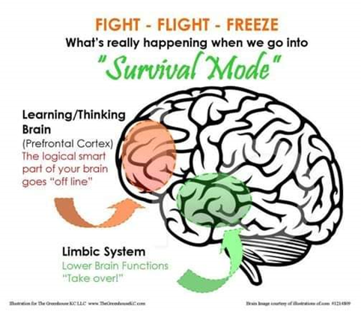
Fight Flight Freeze
Fight Flight Freeze – A Guide to Anxiety for Kids (youtube.com)
Cambridgeshire County Council's video 'Why I am rude' - a poem about our perception of 'behaviour'.

Slide 13
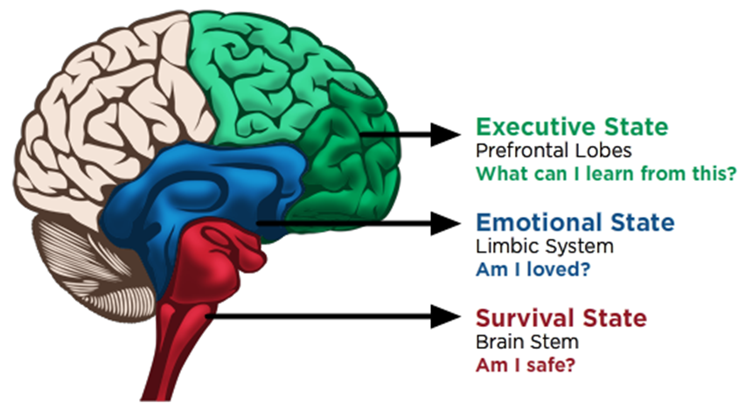
Understanding the Behaviour? / What is the behaviour communicating?/ What is happening physiologically in the body?
What are the different parts of the brain and what do they do? | Cancer Research UK

Slide 14
How we support children mental health in school?
Build positive relationships of trust with the students
Create safe, positive and friendly environments
Allowing time to process information and feelings
Learning about sensations in our bodies PSHE/PSED
Learning about ourselves and developing self awareness and aself esteem (RSE)
Having fun!

Slide 15
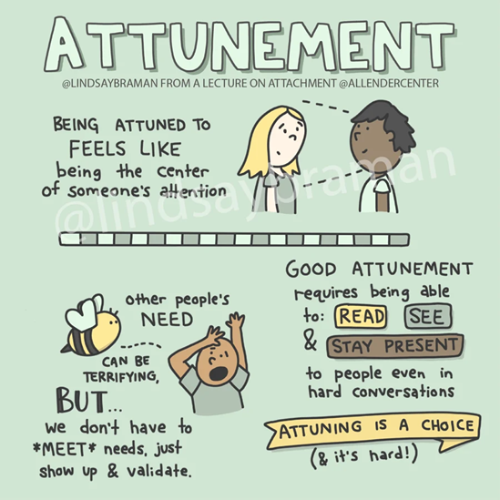
How we support children mental health in school?
Attune – validate – contain – sooth/regulate
Therapy input – OT/SALT support plans and equipment
Zone of regulations
Individual learning plans related with their EHCP SEMH targets
Positive handling plans

Slide 16
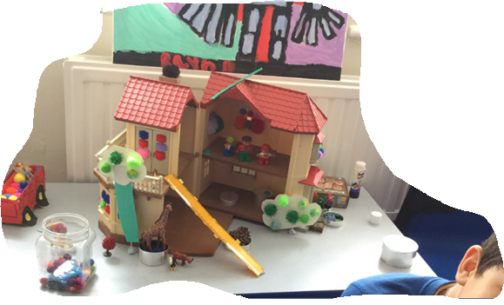
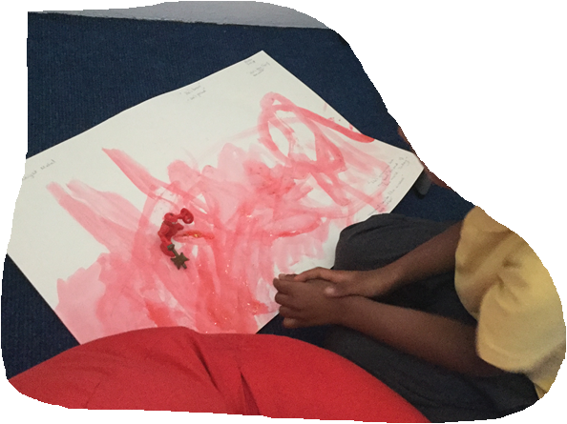
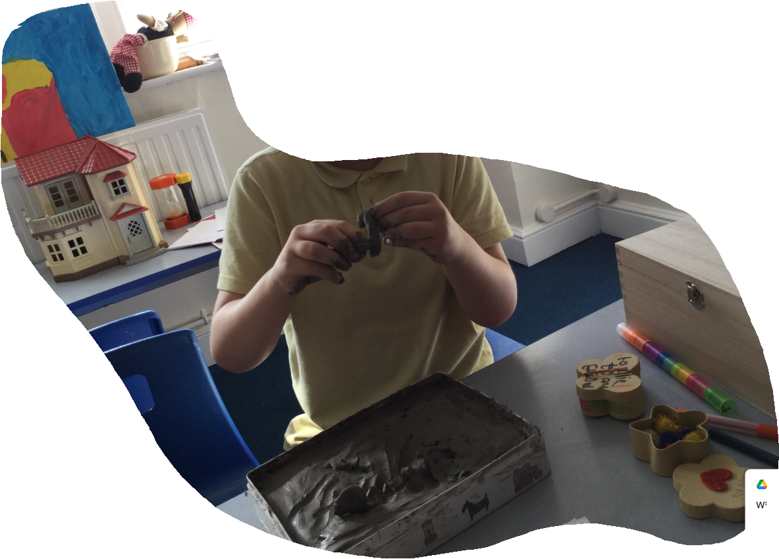
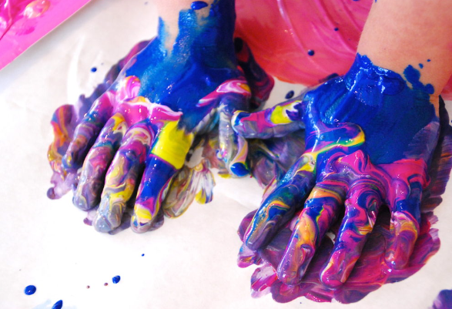
Play and art-based activities

Slide 17
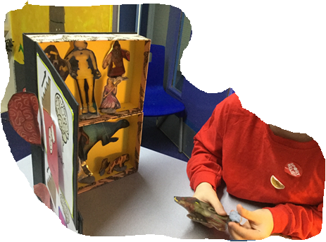
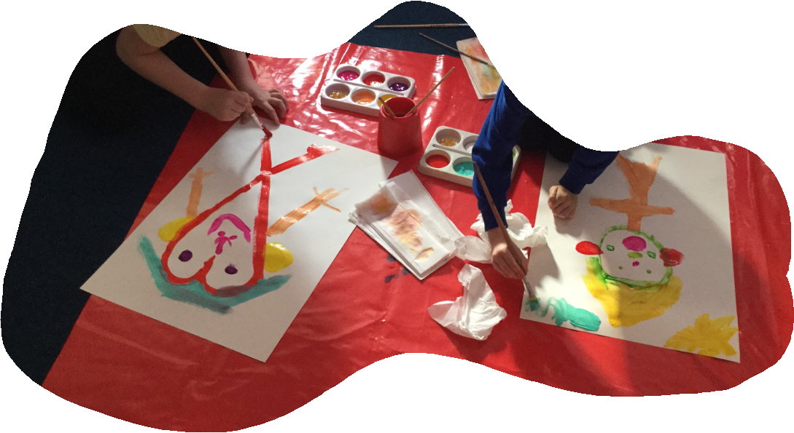
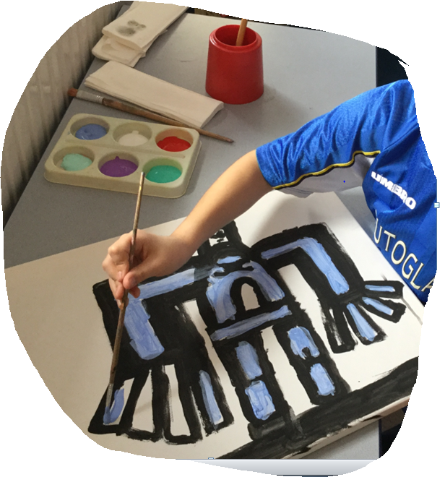
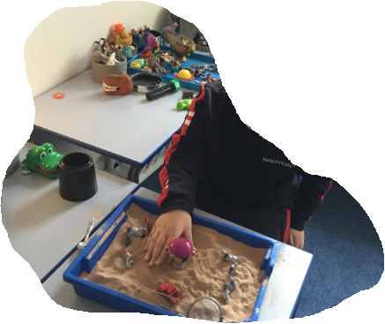
Play and art-based activities
Notes:
Play, and Art-based activities provide opportunities to enhance relationships- and provide opportunities for a child to express themselves, important in the presence of a significant adult, who can wonder, imagine, notice, observe, comment upon e.g. “I can see” ”I wonder if” “I think that…” Working with clay can provide an experience of being grounded, and sensory exploration – the child has to work really hard to manipulate or mould the clay or make forms from it – helps with resilience; working in the sandtray with objects and figures provide opportunities for the safe expression of strong feelings, enacting imaginative worlds, or stories. – the adult can help narrate what’s going on (opportunity to provide language (and wrap it around experience) ; painting can offer safe expression with colours and shapes; music, drams, puppets can be used to – the arts resources providing containment for strong feelings and emotions PACE. The child can rest his ‘social engagement system, release of serotonin rather than the toxic stress hormone, cortisol –calms the nervous system, less tipping into FFF, overtime resilience…

Slide 18
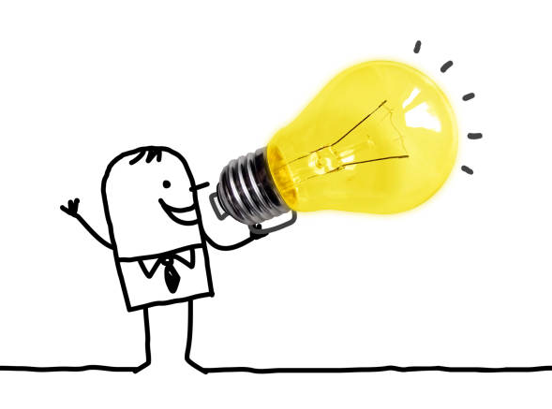
How can you support your child’s mental health at home?

Slide 19
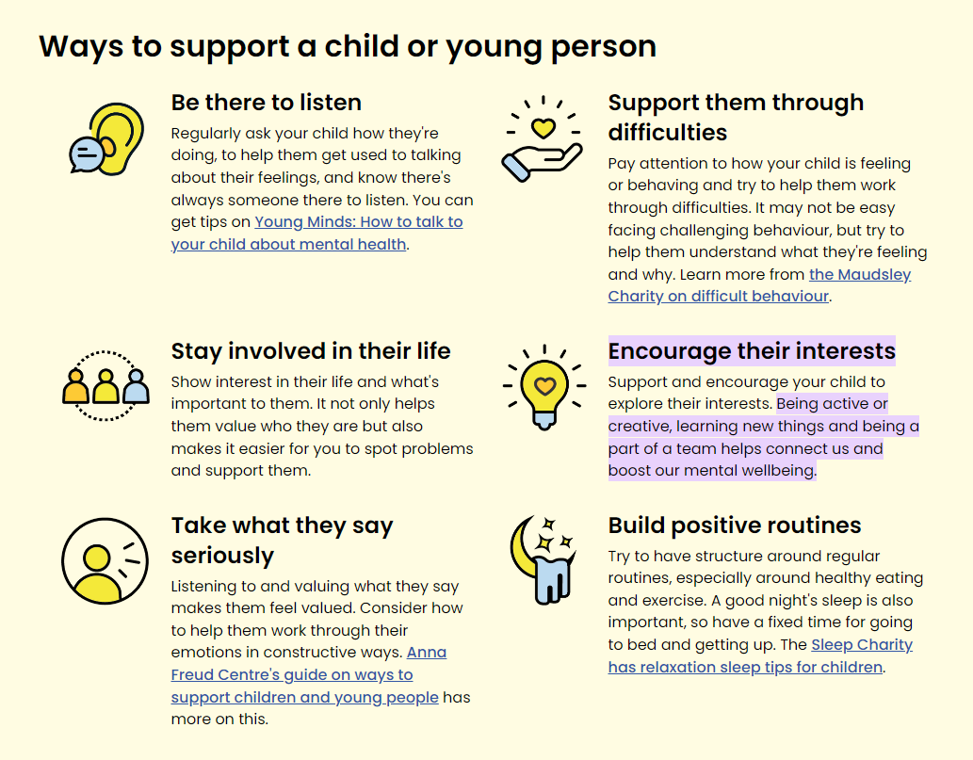
How do you support children’s mental health at home?

Slide 20
To summarize
Repeated positive, shared relational experiences can help healthy development of neuronal pathways in the brain related to shaping the stress regulation systems → reduced fight, flight and freeze responses → increase ‘window of tolerance’ or ability to manage stress/frustration → builds resilience and inner resources over time
Repeated experiences of co-regulation from the adult needs to happen before a child can move into self-regulation > able to use strengthened inner resources to help develop emotional regulation > so more able to be in relationship and start to learn

Slide 21
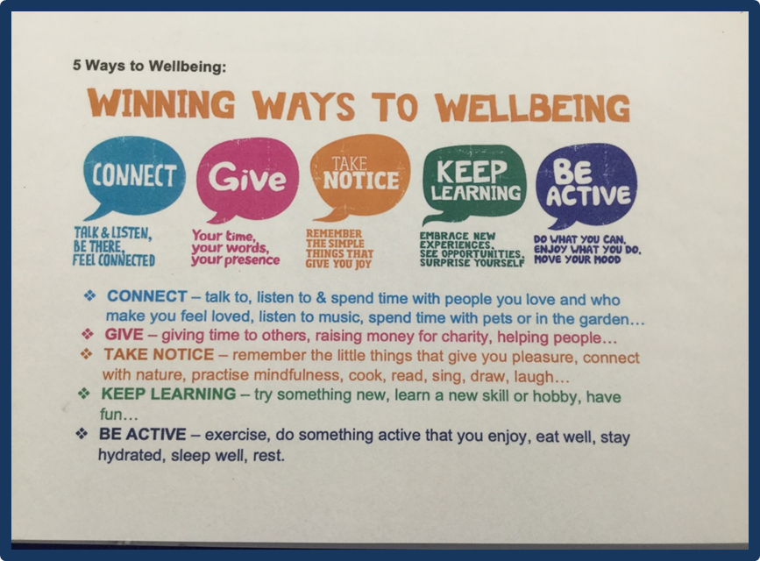
They help people take care of their mental health and wellbeing.
Regularly practicing the 5 Ways is beneficial for everyone – whether you have a mental health problem or not.

Slide 22

Any questions?

Slide 23

Website:
https://www.myfamilycoach.com/register/ -
Password:
M2F4CFR!

