Slide 1


Slide 2

Family Workshop
© 2024 Team Teach Ltd. All rights reserved.
These Family Workshop slides are the property of Team Teach Ltd and are protected by copyright law. Only individuals undertaking Team Teach Family Engagement Training are authorised to use these slides to deliver Family Workshops to parents and carers within their own organisation. Unauthorised sharing or distribution of this resource is strictly prohibited.

Slide 3





Understanding Behaviour
To equip families with knowledge and understanding about behaviour.
To help parents and carers develop skills in positive listening and learning.
To develop skills in positive behaviour support including verbal and non-verbal communication, diversion and de-escalation.
To create positive and supportive relationships within the family and school.
© 2024, Team Teach Ltd

Slide 4

About Team Teach
Team Teach is an accredited, award-winning provider of positive behaviour training. Their framework is designed to focus on positive behaviour support approaches, with an emphasis on good relationships and de-escalation.
Their website, My Family Coach, supports families to understand children's behaviour.
© 2024, Team Teach Ltd

Slide 5
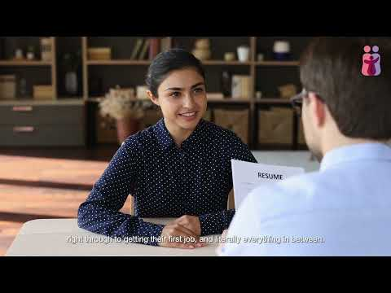
My Family Coach
www.myfamilycoach.com
© 2024, Team Teach Ltd

Slide 6
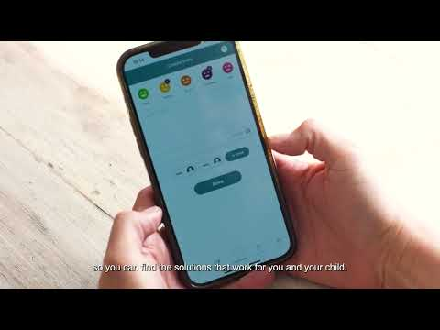
My Family Journal App
www.myfamilycoach.com/journal
© 2024, Team Teach Ltd

Slide 7
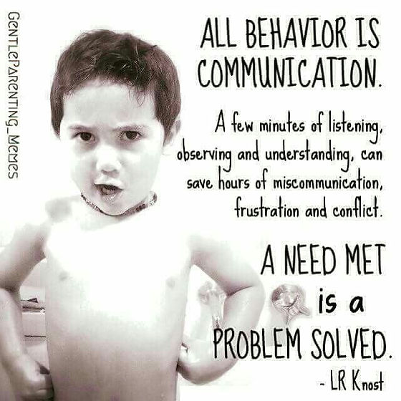
All Behaviour Is Communication
© 2024, Team Teach Ltd

Slide 8
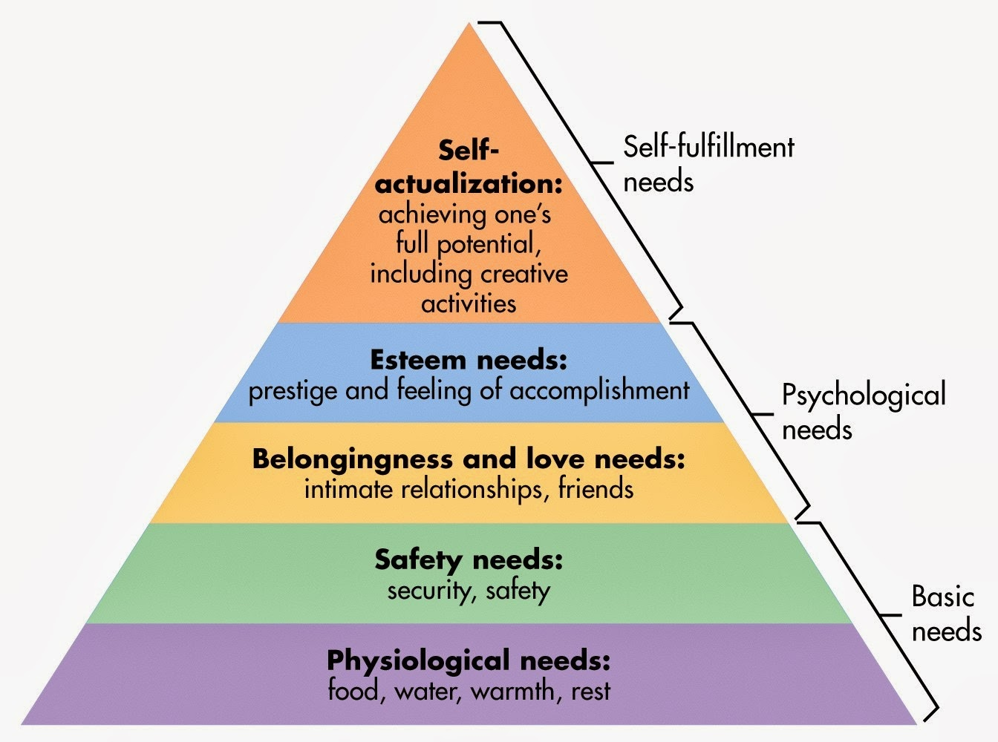
Maslow’s
Hierarchy
What pushes your buttons?
© 2024, Team Teach Ltd

Slide 9
Behaviours of Communication
What pushes your buttons?
© 2024, Team Teach Ltd

Slide 10
What pushes their buttons?
Behaviours of Communication
© 2024, Team Teach Ltd

Slide 11
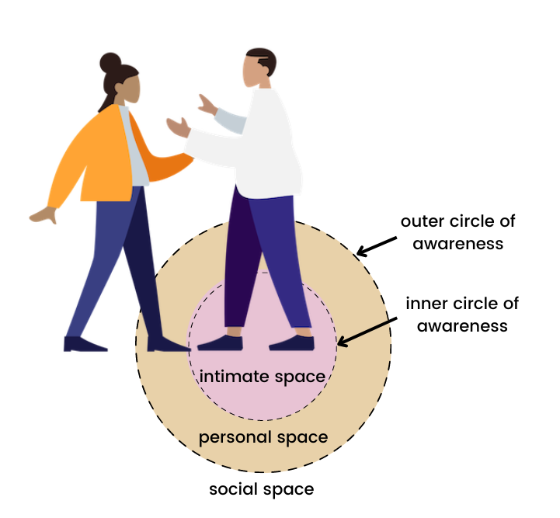
Circles of Awareness
© 2024, Team Teach Ltd

Slide 12
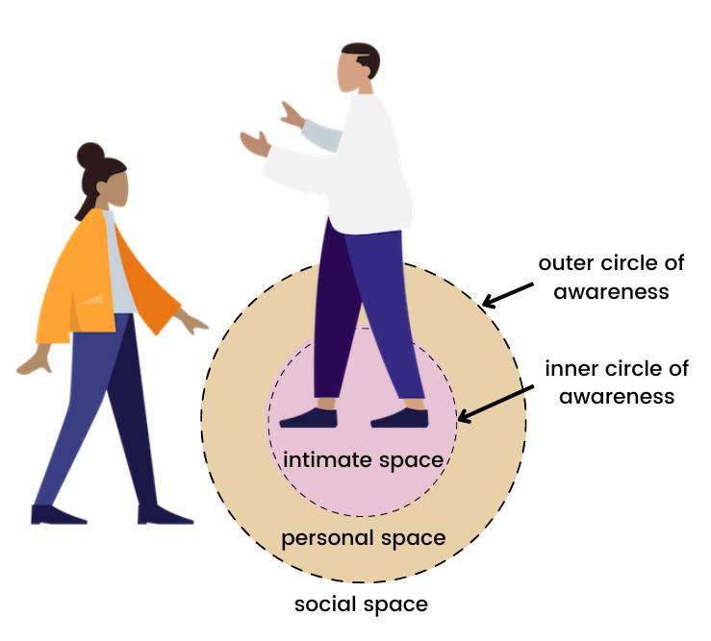
Circles of Awareness
© 2024, Team Teach Ltd

Slide 13
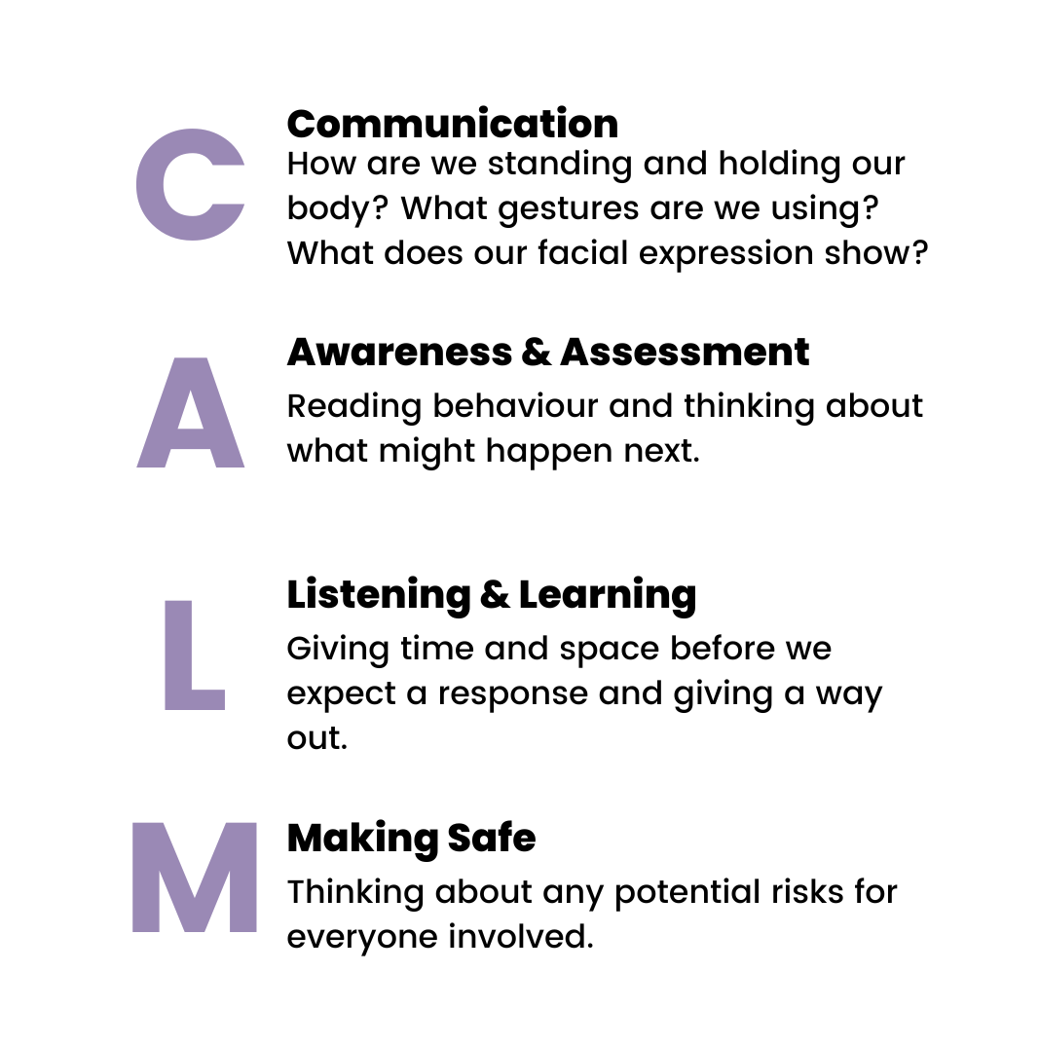
CALM Communication
© 2024, Team Teach Ltd

Slide 14

CALM Communication
We consider the body language we use.
We consider the words we use.
We think carefully about what we are saying.
We remember that behaviour is communication and think about what it's telling us.
© 2024, Team Teach Ltd

Slide 15
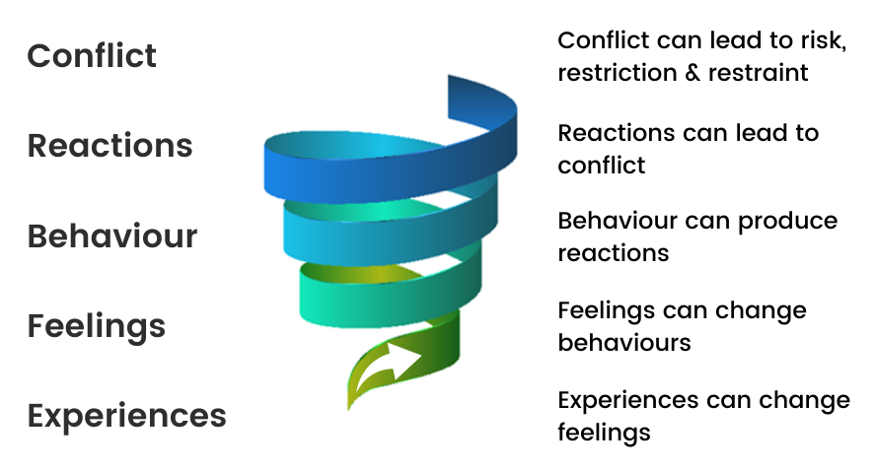
The Conflict Spiral
© 2024, Team Teach Ltd

Slide 16
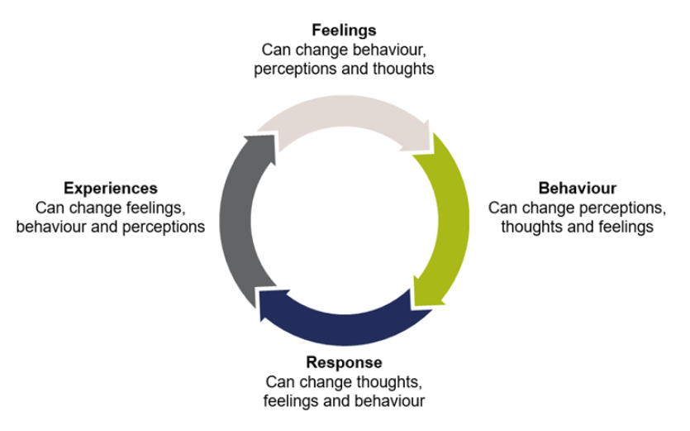
Cycle of Influence
© 2024, Team Teach Ltd

Slide 17
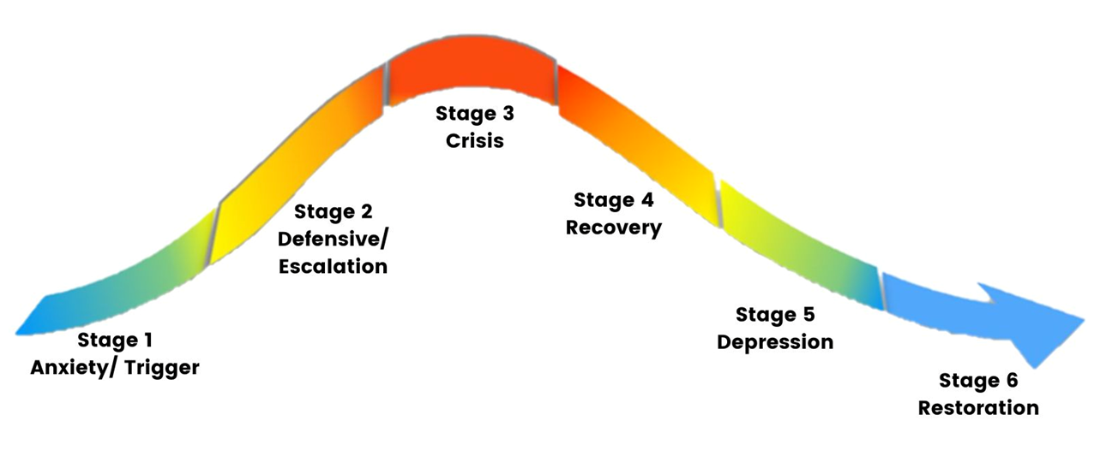
Stages of Distress & Support
© 2024, Team Teach Ltd

Slide 18

95% Positive Behavioural
Support
Crisis Management
Diversion De-escalation
Positive Behavioural Supports
95%
© 2024, Team Teach Ltd

Slide 19
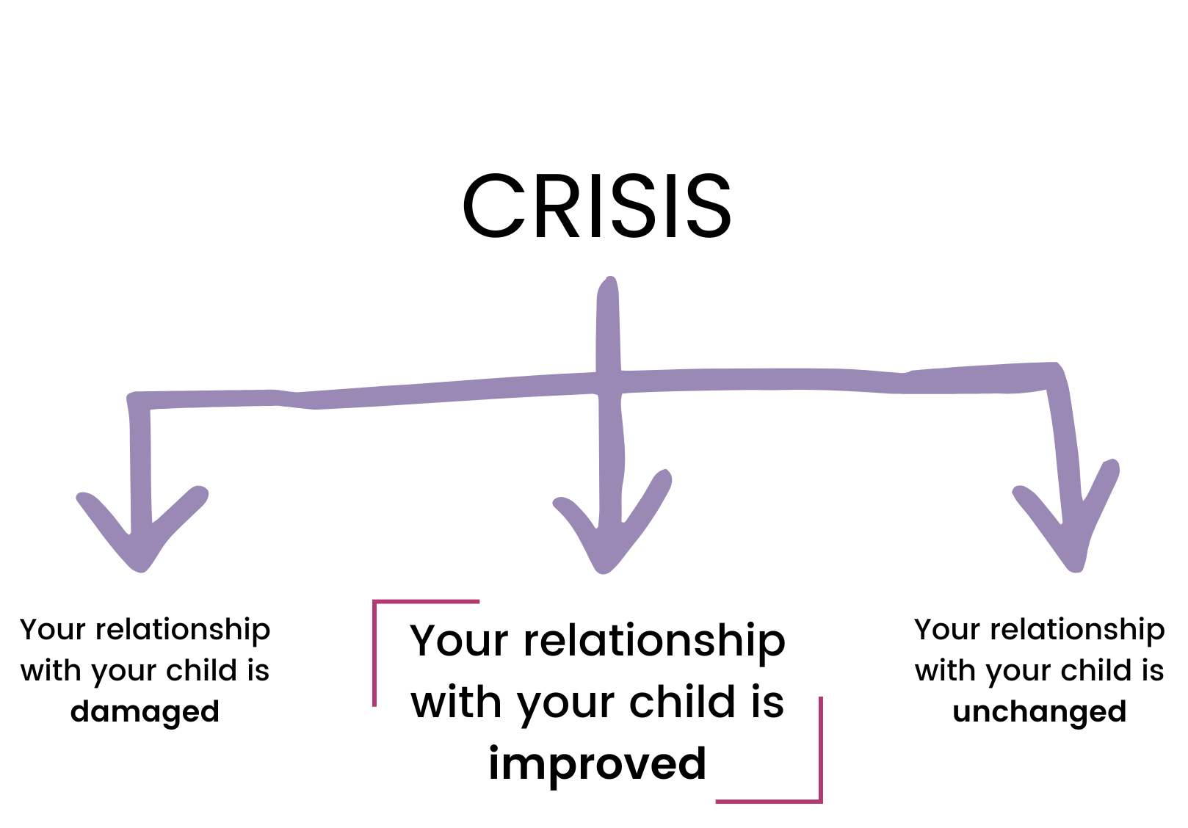
Listening & Learning
© 2024, Team Teach Ltd

Slide 20
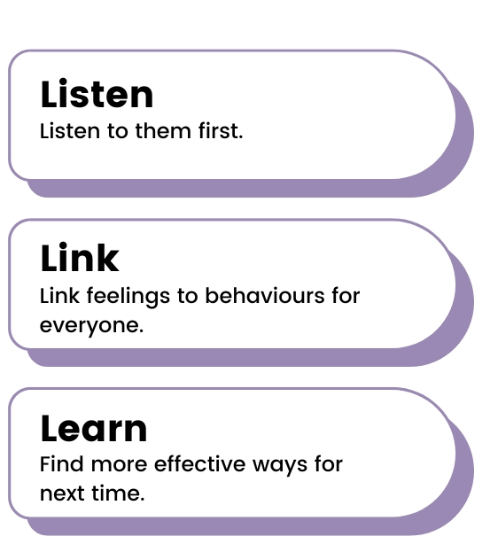
Listening & Learning
© 2024, Team Teach Ltd

Slide 21
Next Steps
STOP
START
CONTINUE
© 2024, Team Teach Ltd
Notes:
Issues
Identify 3 things you want to do – either, stop, start, or continue
Action planning

Slide 22
Family Workshop

