Slide 1
Creating Sensory Resources at home
Parents workshop

Slide 2
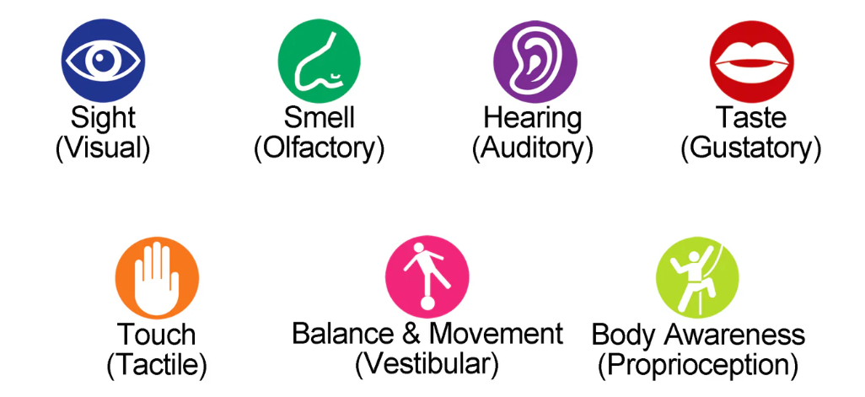
Engaging the Senses in play and learning
Sensory resources are any activity that stimulates our senses. It helps children interact with and make sense of the world that surrounds them. It can involve a wide range of activities and materials; from squishing and moulding playdough, to exploring different textures and scents.

Slide 3
Why is it important?
Sensory activities play an important role in a child’s learning and development. Much of our learning comes through our ability to use our senses to retain information.
Sensory activities are also shown to support:
  language development
  cognitive development
  fine and gross motor skills
  problem-solving
  social development
  Concentration and observation skills
  Sensory activities are beneficial in helping to calm anxious and frustrated children.
Some children may have a sensory sensitivity or need. Every child who has a sensory sensitivity is different, and their needs may change over time.
Notes:
Engaging in sensory play offers a multitude of benefits for your child's development and overall well-being. Here are some of the key advantages:
Enhanced sensory processing:
Sensory play helps children develop their sensory processing skills, allowing them to better interpret and respond to sensory information in their environment; such as listening to nature as well as being able to hear any danger around them.
Language development:
Through sensory play, children are exposed to a variety of textures, sounds, and smells, which helps expand their vocabulary and improve their communication skills. They can also learn new words to describe the sensations they are experiencing.
Emotional regulation:
Sensory play provides a safe and calming outlet for children to explore and express their emotions. It can help them relax, reduce stress and anxiety, and regulate their emotions.
Social skills development:
Sensory play can be a great way for children to engage in cooperative play and develop social skills. When children engaged in sensory activities together, they learn to take turns, share materials, and communicate effectively with their peers.

Slide 4
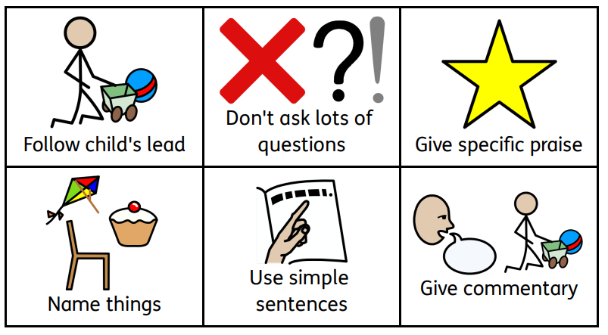
Inclusive for all
Sensory activities can be adapted for different ages, needs and abilities. By incorporating sight, touch, smell, taste, and hearing, they are a great way to create memorable learning experiences.
Everyone benefits from sensory activities. Whether it be for the calming effects, gaining new skills, or to have engaging adult child interactions (ACI).

Slide 5

What Sensory resources can you make at home?
Sensory activities are simple to set up, generally requiring just a handful of items you’ll most probably already have in your home. Whilst some sensory activities are messy but by putting in place simple measures to limit your child’s space, the mess can generally be restricted.
Most of these activities provide a multi-sensory input.

Slide 6

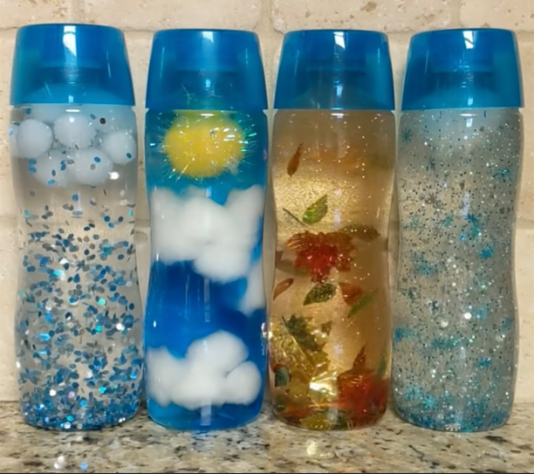
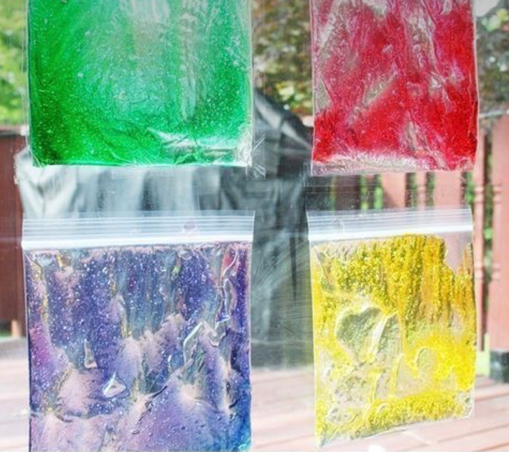
Sensory bottles/bags:
Fill clear plastic bottles with water and add different food colouring. Secure the lids tightly and let your child shake and observe the colours mixing together. You can also add in glitter and oil.
Fill a sandwich bag with gel or oil and add food colouring. Secure the seal with tape. Your child can explore the textures. You can also add a learning element to it such as drawing letters or numbers in it.

Slide 7
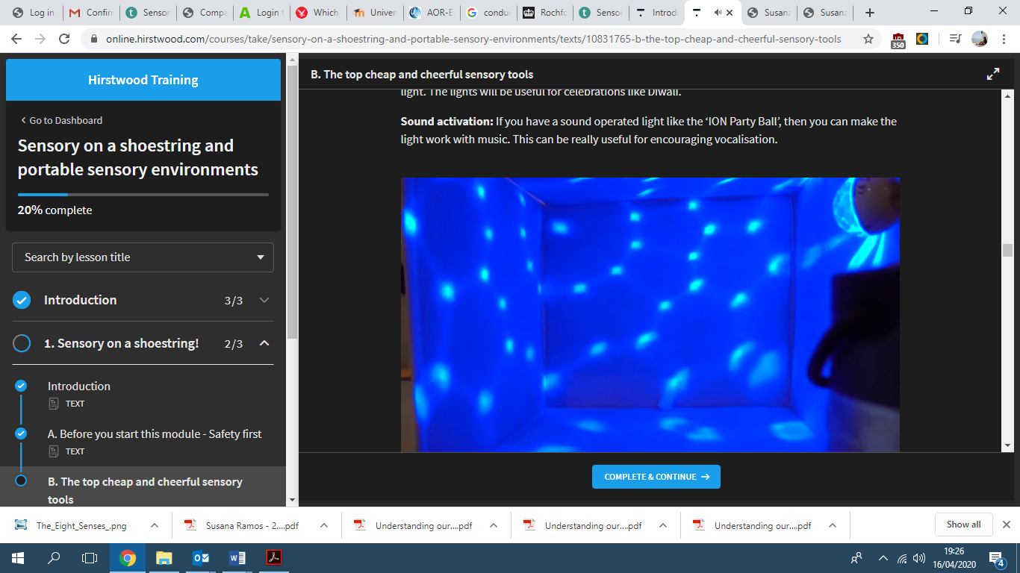
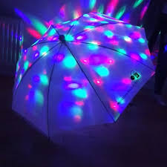
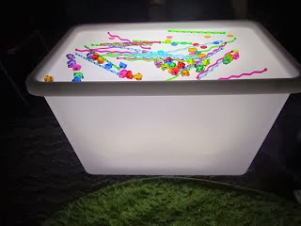
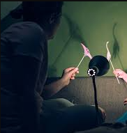
Shadow and light
Use lights to create patterns on a wall , umbrella or a box. Encourage your child to experiment with different objects and shapes to create interesting patterns. Finding some coloured tissue paper or coloured translucent pots/lids will allow the patterns to change colours.

Slide 8
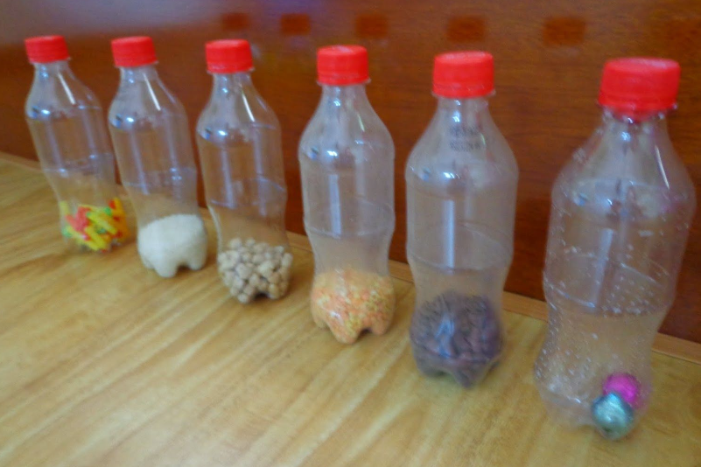
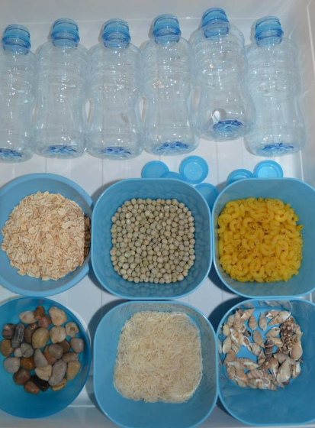
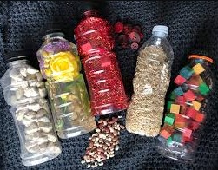
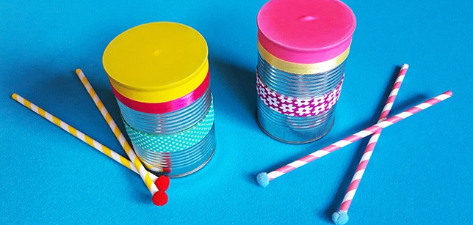
Sound bottles
Fill transparent bottles with different materials, such as rice, beans, or bells. Seal them tightly and let your child shake and listen to the different sounds produced. Perfect homemade musical instruments using recycled objects.

Slide 9
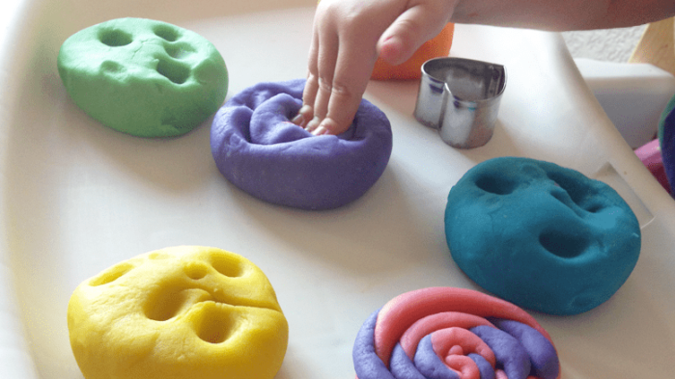
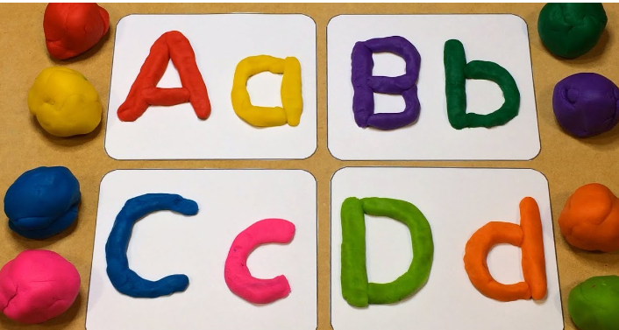
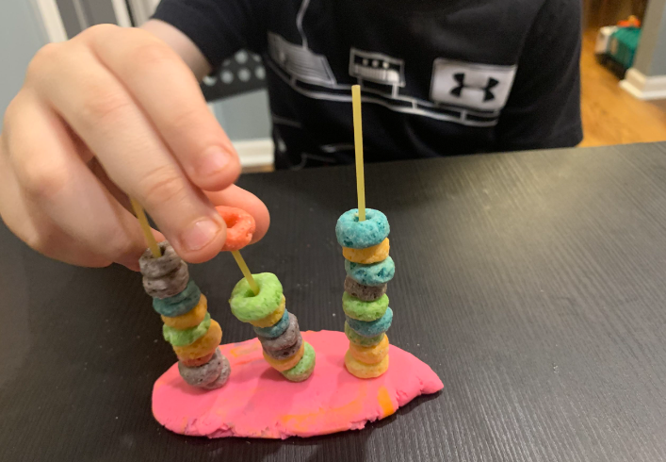
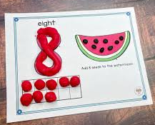
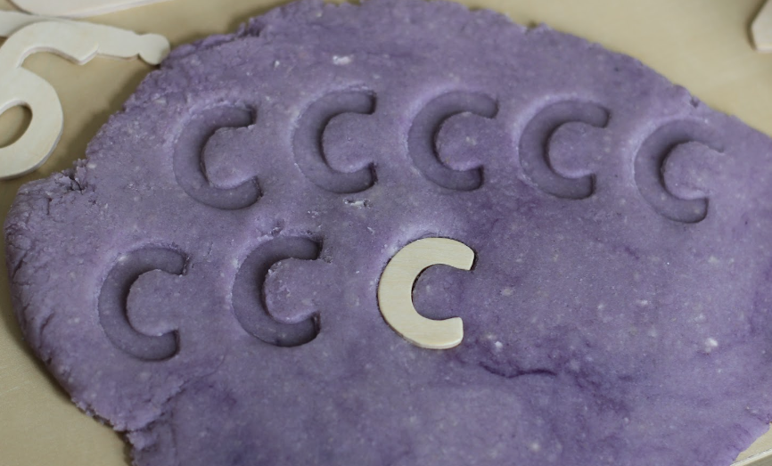
Playdough
Homemade playdough is a versatile sensory material. Encourage your child to squeeze, mould, and create different shapes using their hands. It can be great for maths, English and fine motor activities as well.
Add different scents, such as vanilla, lavender, or citrus, to homemade or store-bought playdough. Let your child explore the different smells while playing.

Slide 10
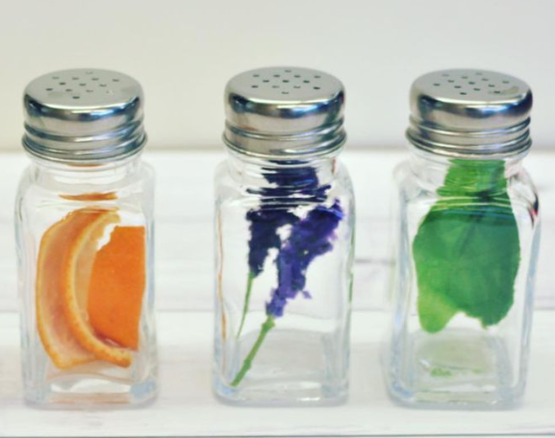
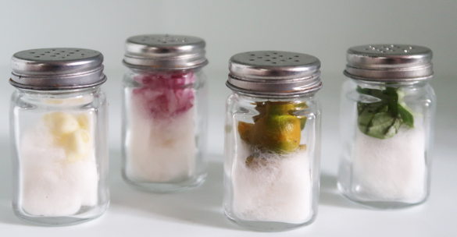
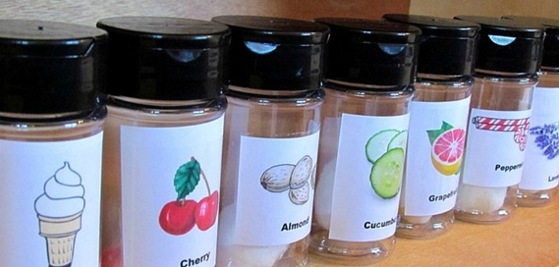
Scented sensory bottles
Fill small bottles with scented oils or extracts, such as peppermint or lemon (word of caution: only add a little). Secure the lids tightly and pierce holes in the lids; let your child smell the different scents.

Slide 11
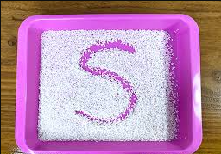

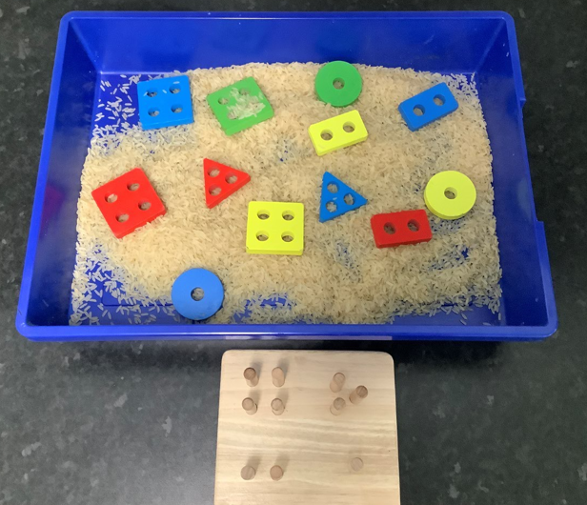
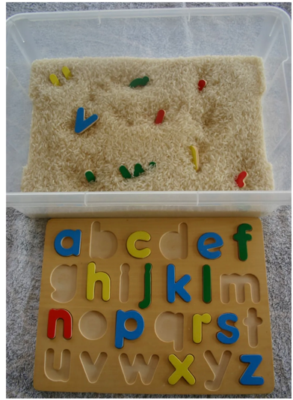
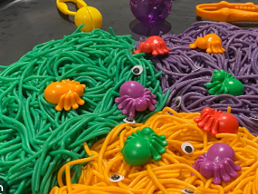
Sensory bins and trays
Fill a large plastic container with various materials such as rice, beans, or sand. Add small toys or objects for your child to search for and discover using their sense of touch.

Slide 12
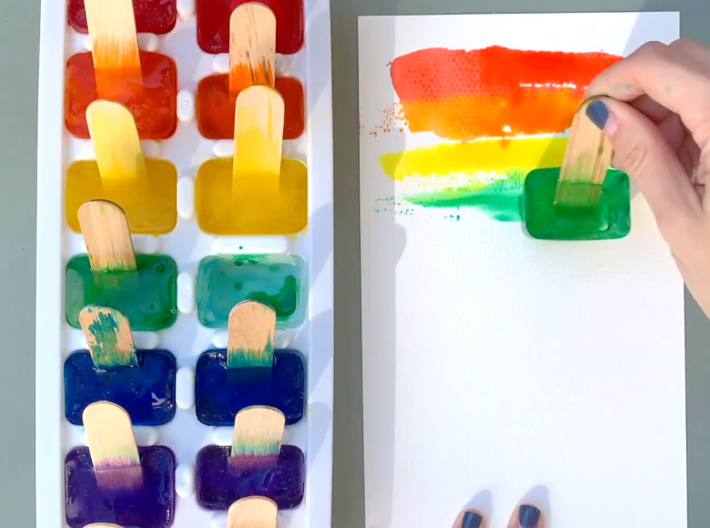
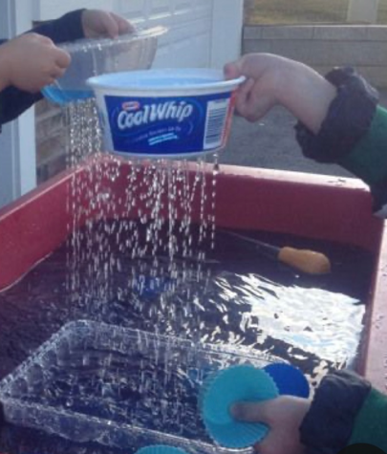
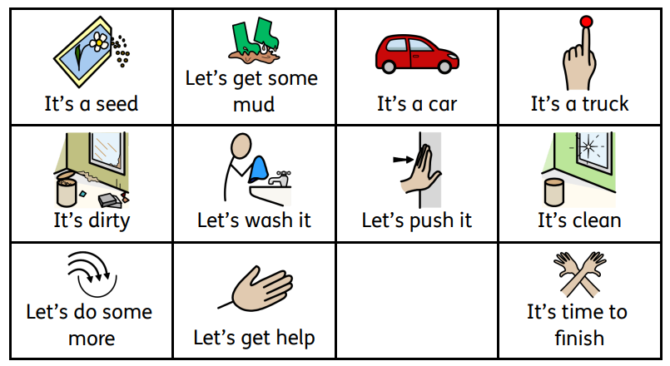
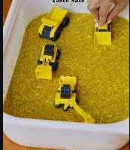
Water and messy play
Set up a water table or fill a bowl with water and provide cups, funnels, and sponges for your child to explore different water textures and temperatures.
Remember, touch doesn’t have to be with only hands, feet can also touch sensory objects: sand, grass, tiles etc

Slide 13
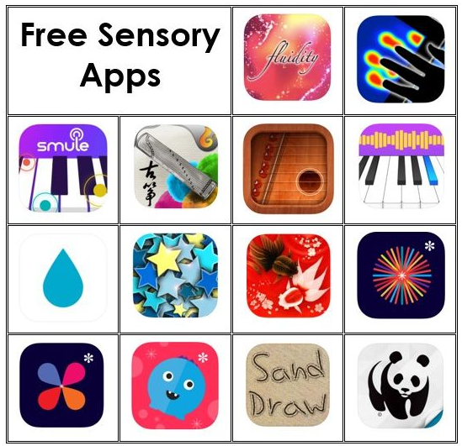
Apps
Fluidity
Air harp
Magic piano
Wa kingyo le goldfish pond
WWF together
Dropophone
Heatpad
Sand draw

Slide 14
Please don’t forget to fill in the form provided, so you can receive resources and example recipes.
Thank you!

