Slide 1
Managing Behaviours
Parent Workshop
New Oaks 9:30am
Led by Laura Gonzalez

Slide 2
Workshop Aim
To provide parents with simple and practical tools to support behaviour at home.
To help children regulate their emotions and feel safe and understood.

Slide 3
Important message:
This workshop is not about blaming parents.
All behaviour is communication.
Our children communicate in different ways.

Slide 4
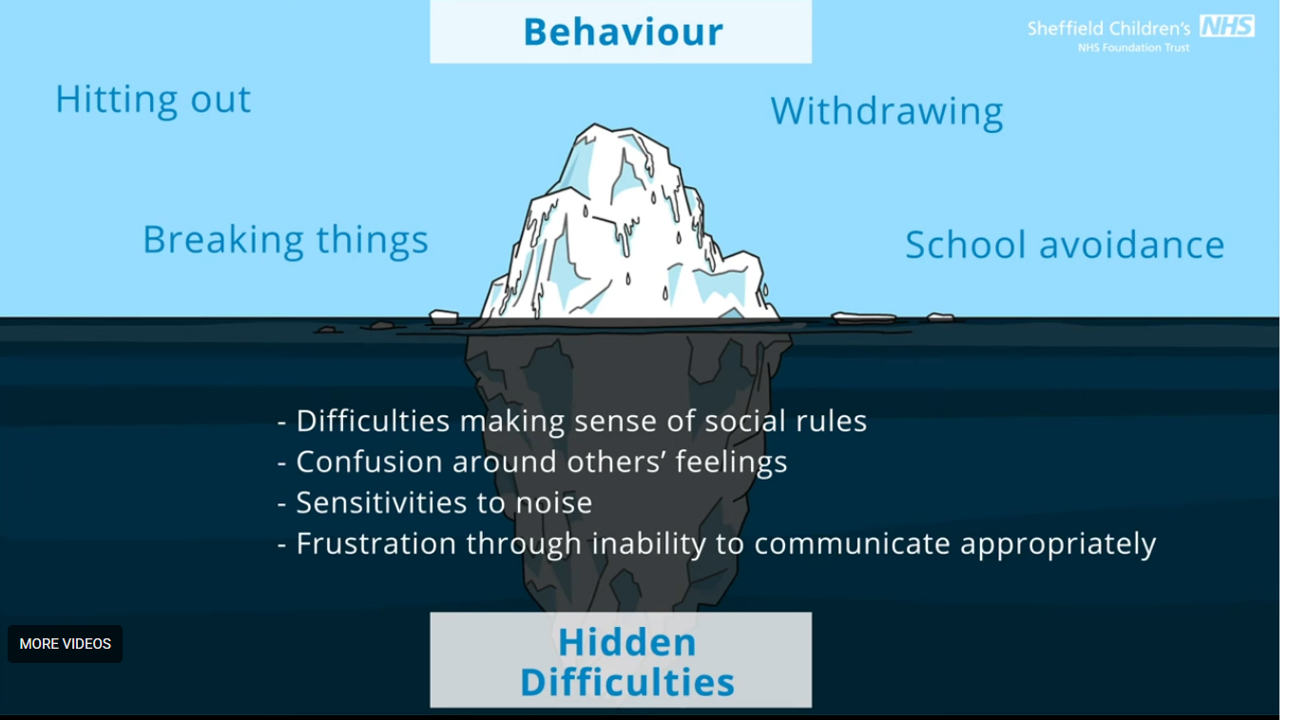
Why behaviour can be challenging:
Many children struggle with change, noise and transitions.
Some children find it hard to understand instructions.
Some children find it hard to express feelings or needs.

Slide 5
Behaviour is communication:
What happened before the behaviour?
What did your child do?
What happened after?

Slide 6
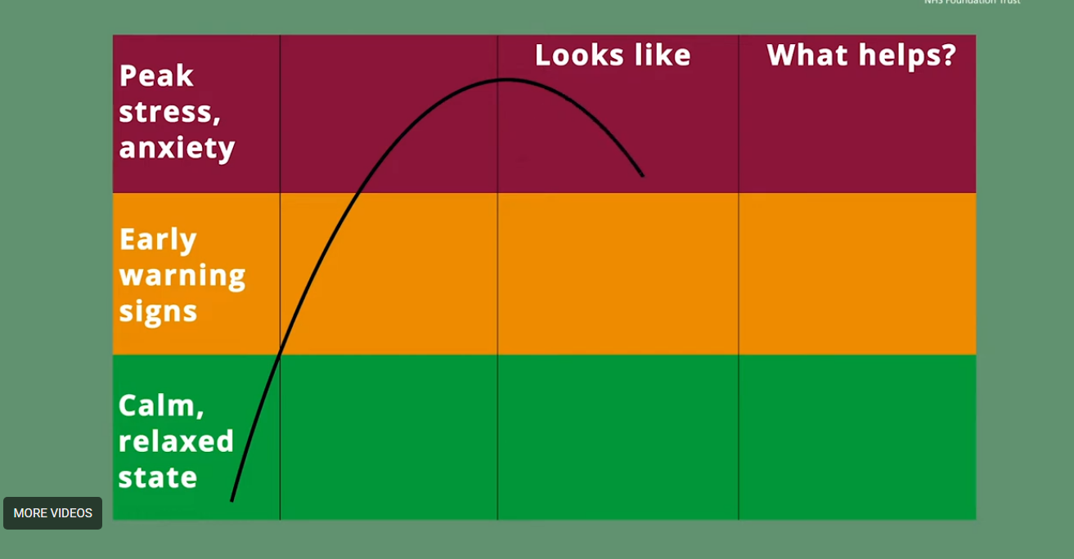
Emotional Regulation Comes First
When children are very upset, their brain is in alarm mode.
They need help to calm before we try to teach or correct.

Slide 7
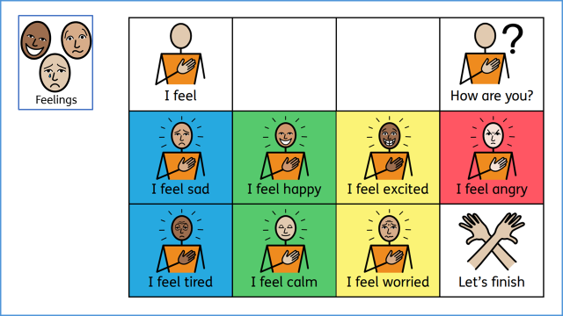
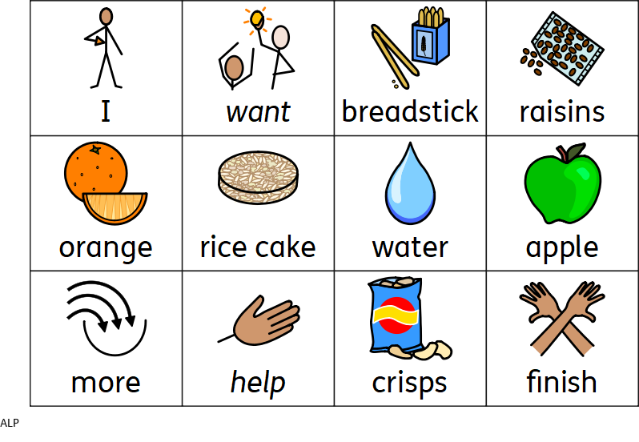
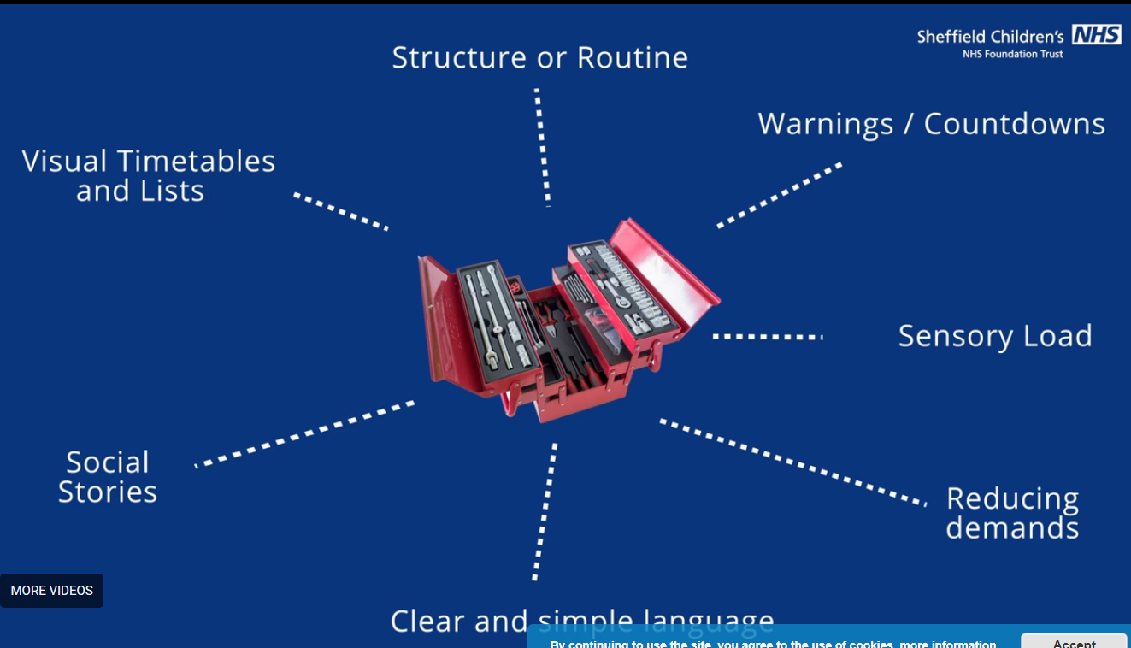
Strategy 1 – Visual Support
Use now / next boards at home.
Use simple picture routines.
Use timers or countdowns.

Slide 8
Strategy 2 – Offer Choices
Offer two simple choices instead of giving commands.
This helps reduce anxiety and power struggles.

Slide 9
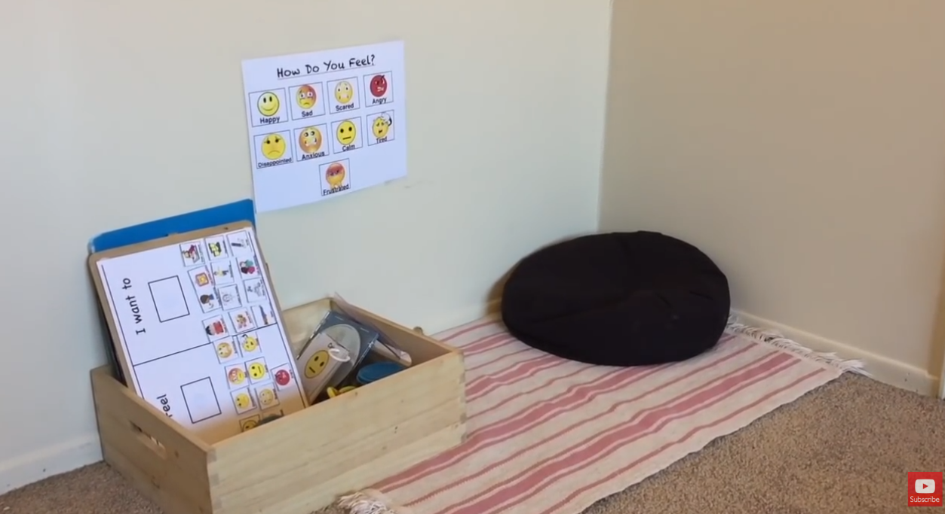
Strategy 3 – Calm Space at Home
Create a small safe and quiet space.
This is not a punishment area.
Children can use it to calm and regulate.

Slide 10
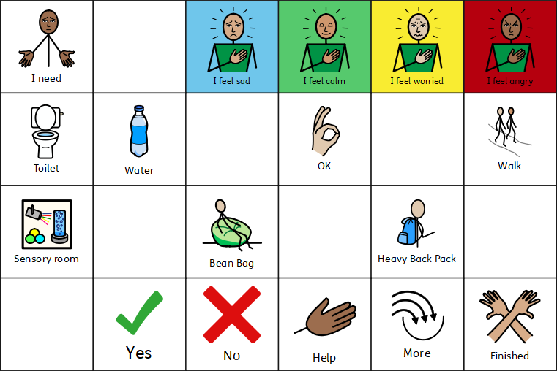
Strategy 4 – Calm First, Talk Later
Support your child to calm down first.
Use quiet time, sitting together, breathing or sensory support.
Talk about behaviour after your child is calm.

Slide 11
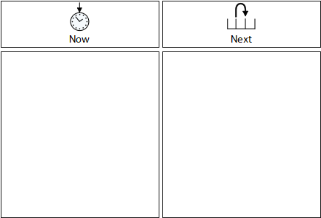
Strategy 5 – Short and Clear Language
Use short and simple instructions.
For example: 'Stop. Hands down.'
'First tidy, then iPad.'

Slide 12
Praise what you want to see:
Notice small successes.
For example: 'Good waiting.' 'Good sitting.' 'Good asking for help.'

Slide 13
Consistency and routine:
Use the same words and routines.
Try to respond in the same way each time.
Small changes can make a big difference.

Slide 14
Thank You
We know supporting children with additional needs at home can be challenging.
We are here to support you.
Please speak to us after the session if you would like help.

